Slide 1
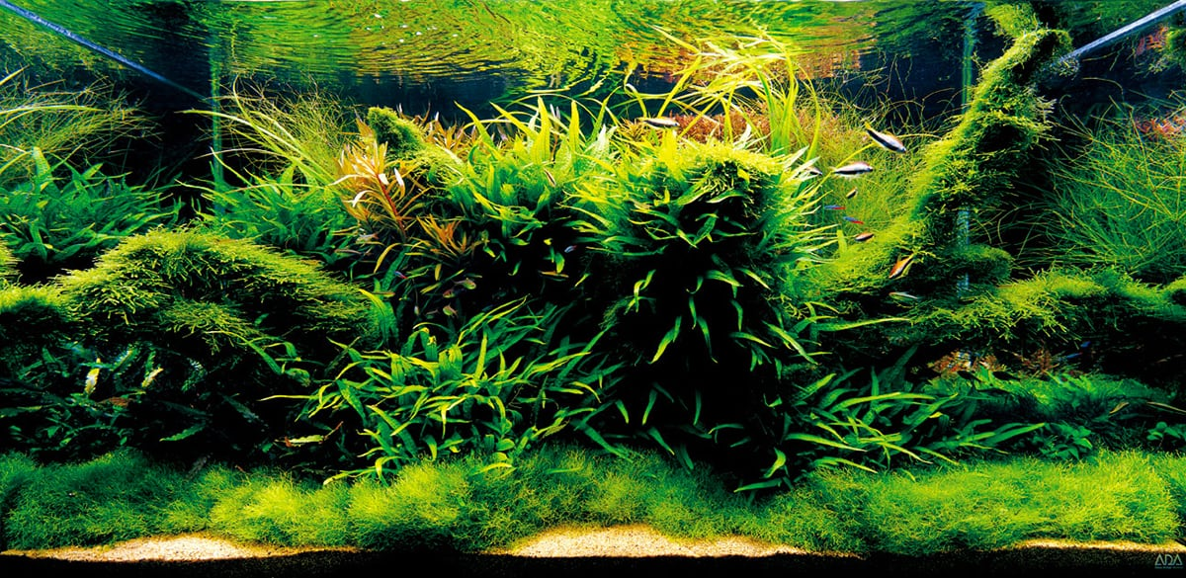
AQUASCAPING 101
Creating your first scape

Slide 2
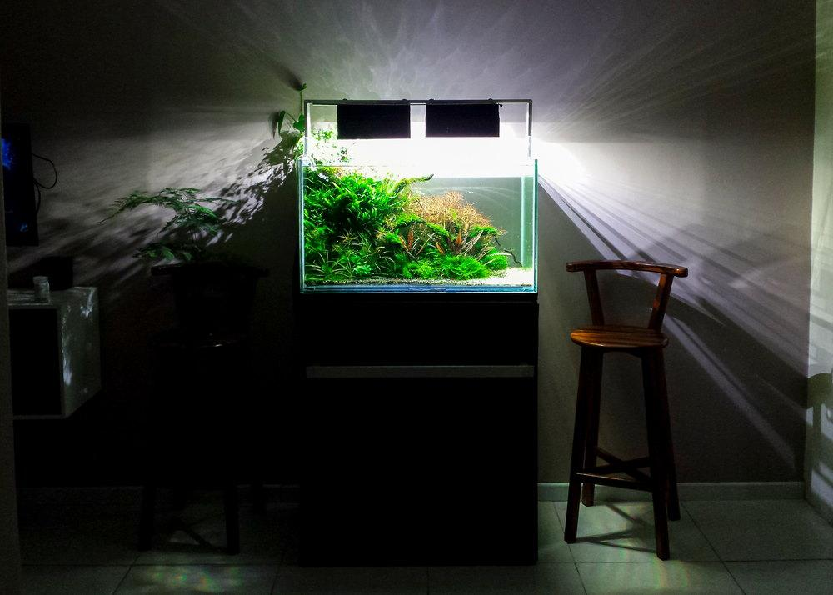
In this module, you will learn:
What is Aquascaping
Pre-requisites
Planning
Build Order
Initial Maintenance
Regular Maintenance

Slide 3
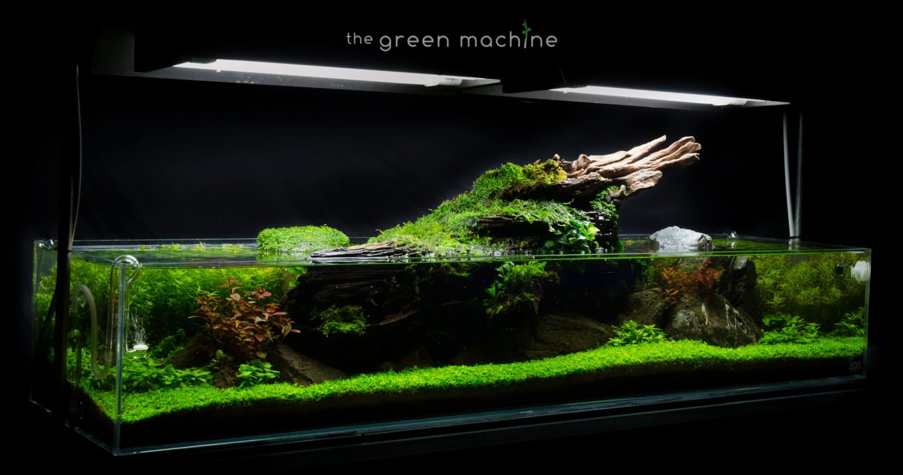
What is Aquascaping?
Aquascaping is the craft of arranging aquatic plants, as well as rocks or driftwood, in an aesthetically pleasing manner to replicate nature as closely as possible within an aquarium.

Slide 4
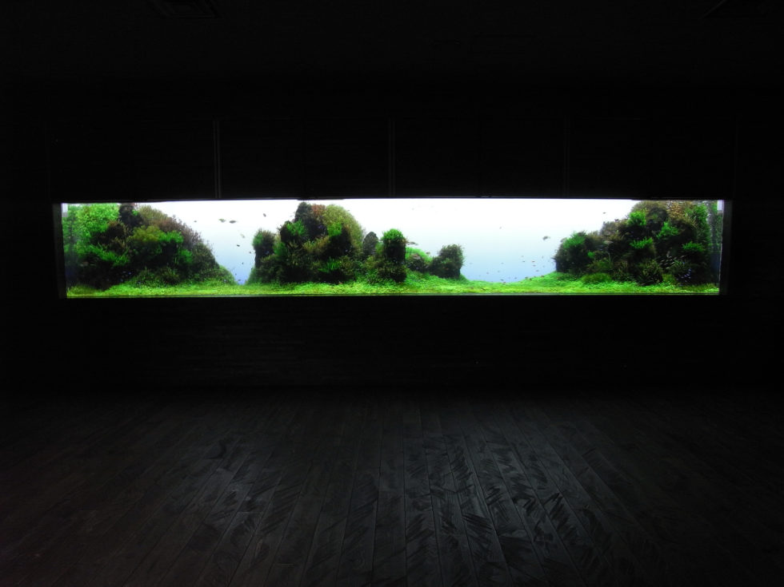
Pre-requisites
Space
To have a dedicated space for your tank as well as external components
Time
To dedicate some time everyday to maintain a healthy aquascape while waiting patiently for it to flourish
Money
To meet the economic demands that come with the purchase of every individual item/component.

Slide 5
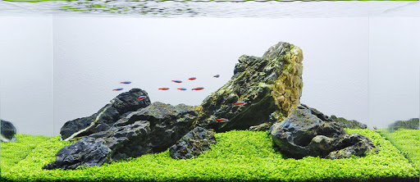
Planning
Planning out what you want in advance is key and can save you from MTS (Multiple Tank Syndrome)
THE SYSTEM
The basic components that make up your system
Aquarium / External Components / Internal Components
Conceptual arrangement of different components
THE DESIGN
Different styles / Inspiration / Useful Visualising Tools

Slide 6
The System
The Aquarium
Size: 60cm*40cm*30cm (L-B-H)

